Slide 1
Quora Question Pairs
COMPUTER SCIENCE AND ENGINEERING
SUDIPTA HALDER
UNIV ROLL NO – 10400116059
SMITA BANDYOPADHYAY
UNIV ROLL NO - 10400116078

Slide 2
Problem Description
100 million people visit Quora every month.
People often post the same questions but frame them differently.
We want to make content discovery easier, for better search & relevance, recommendations, autocomplete etc.
The goal is to discover whether two questions have the same intent!

Slide 3
Real world/Business Objectives and Constraints
The cost of a mis-classification can be very high.
You would want a probability of a pair of questions to be duplicates so that you can choose any threshold of choice.
No strict latency concerns.

Slide 4
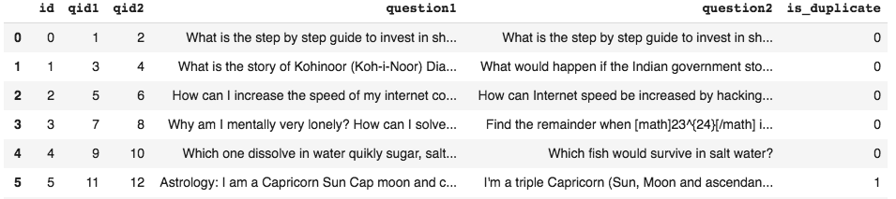
Some Examples

Slide 5
Data Overview
Data will be in a file Train.csv
Train.csv contains 5 columns : qid1, qid2, question1, question2, is_duplicate
Size of Train.csv - 60MB
Number of rows in Train.csv = 404,290

Slide 6
Type of Machine Learning Problem
It is a binary classification problem, for a given pair of questions we need to predict if they are duplicate or not.
Metric(s):
log-loss
Binary Confusion Matrix

Slide 7
Some Facts about Data
Total number of question pairs for training: 404290
Question pairs are not Similar (is_duplicate = 0): 63.08%
Question pairs are Similar (is_duplicate = 1): 36.92%
Total number of Unique Questions are: 537933
Max number of times a single question is repeated: 157

Slide 8
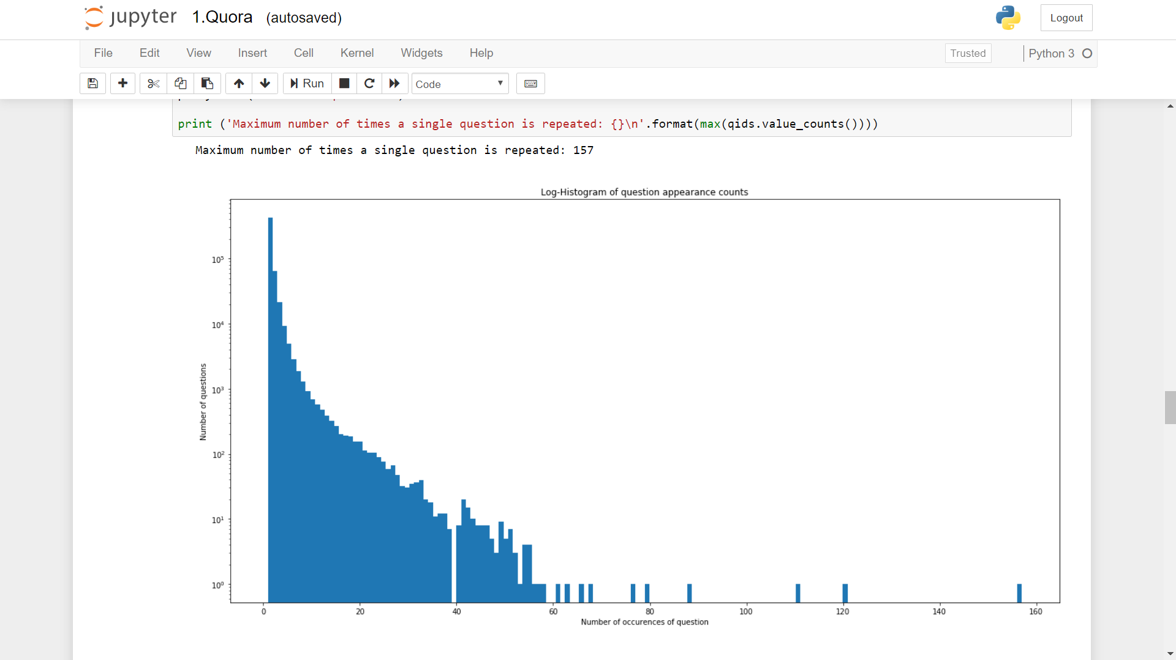
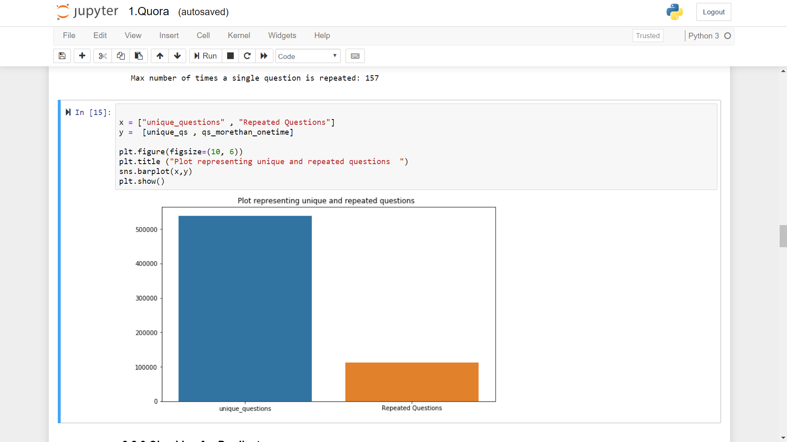

Slide 9
Basic Feature Extraction (before cleaning)
freq_qid1 = Frequency of qid1's
freq_qid2 = Frequency of qid2's
q1len = Length of q1
q2len = Length of q2
q1_n_words = Number of words in Question 1
q2_n_words = Number of words in Question 2
word_Common = (Number of common unique words in Question 1 and Question 2)
word_Total =(Total num of words in Question 1 + Total num of words in Question 2)
word_share = (word_common)/(word_Total)
freq_q1+freq_q2 = sum total of frequency of qid1 and qid2
freq_q1-freq_q2 = absolute difference of frequency of qid1 and qid2

Slide 10
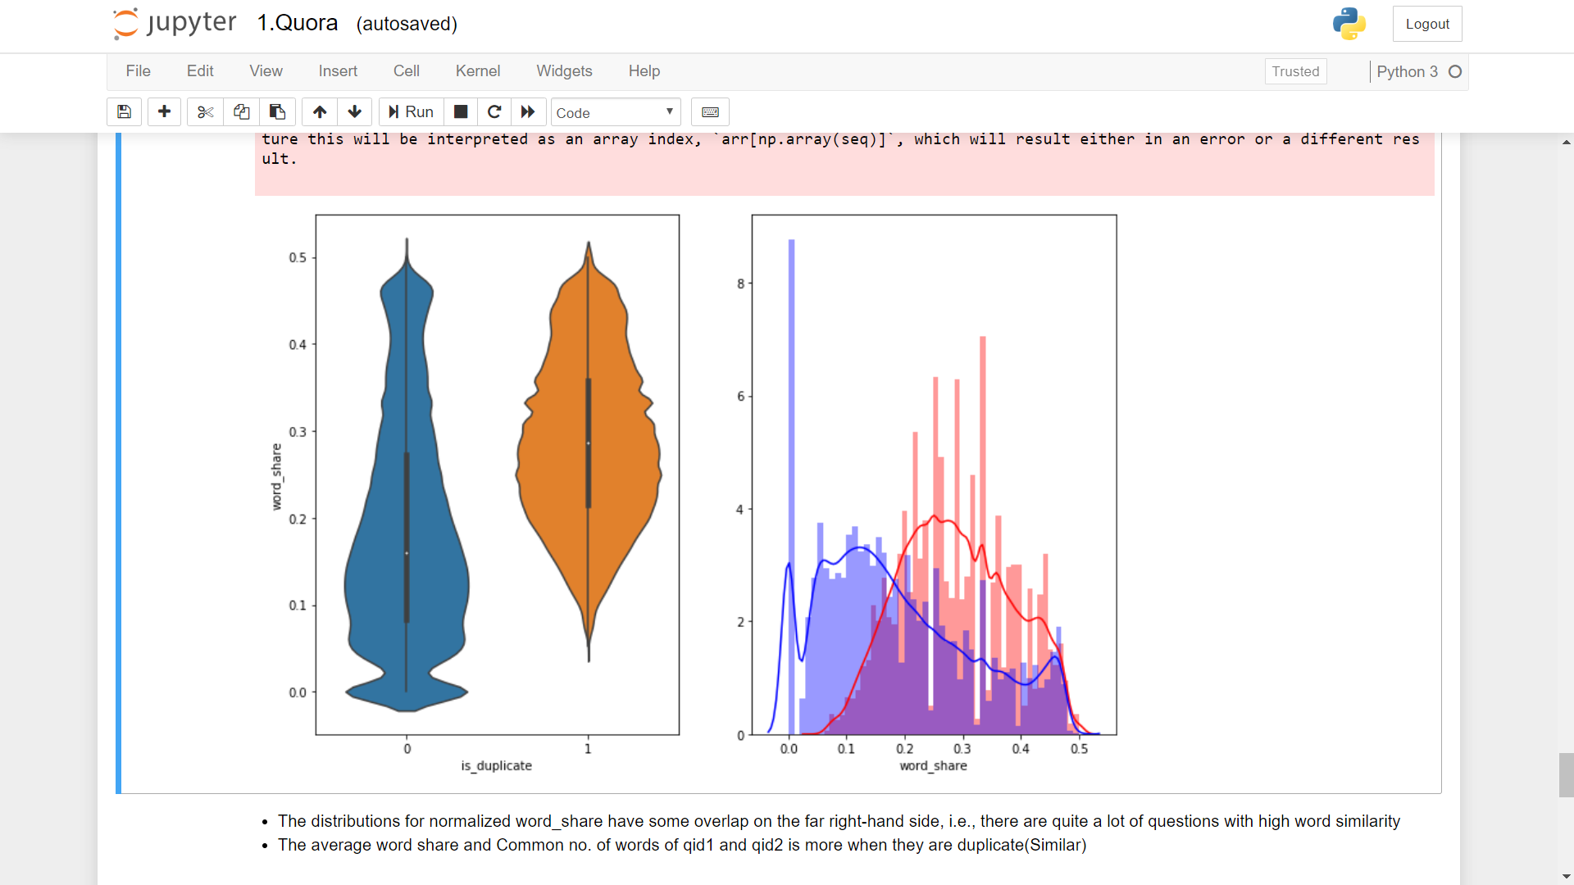
The distributions for normalized word_share have some overlap on the far right-hand side, i.e., there are quite a lot of questions with high word similarity
The average word share and Common no. of words of qid1 and qid2 is more when they are duplicate(Similar)

Slide 11
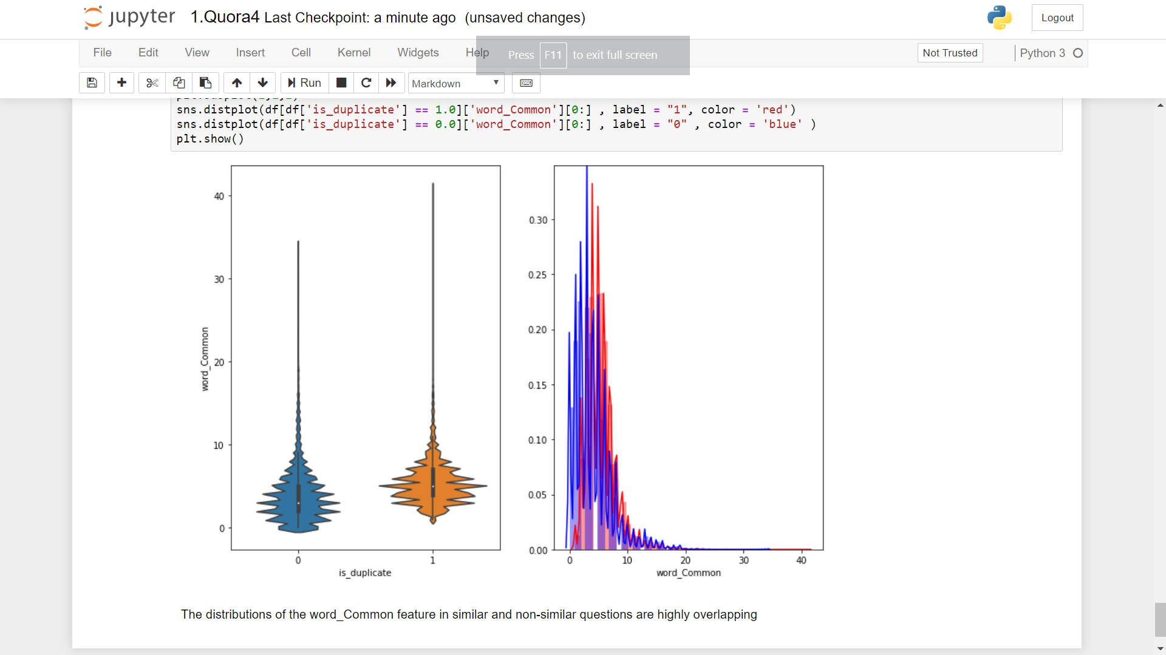
The distributions of the word_Common feature in similar and non-similar questions are highly overlapping

Slide 12
Pre-processing of Text
Removing html tags
Removing Punctuations
Performing stemming
Removing Stopwords
Expanding contractions etc.

Slide 13
Advanced Feature Extraction (NLP and Fuzzy Features)
cwc_min = common_word_count / (min(len(q1_words), len(q2_words))
cwc_max = common_word_count / (max(len(q1_words), len(q2_words))
csc_min = common_stop_count / (min(len(q1_stops), len(q2_stops))
csc_max = common_stop_count / (max(len(q1_stops), len(q2_stops))
ctc_min = common_token_count / (min(len(q1_tokens), len(q2_tokens))
ctc_max = common_token_count / (max(len(q1_tokens), len(q2_tokens))
Last_word_equivalent
first_word_equivalent

Slide 14
Continued…
Fuzz_ratio
Fuzz_partial_ratio
Token_sort_ratio
Token_set_ratio
Longest_substring_ratio

Slide 15
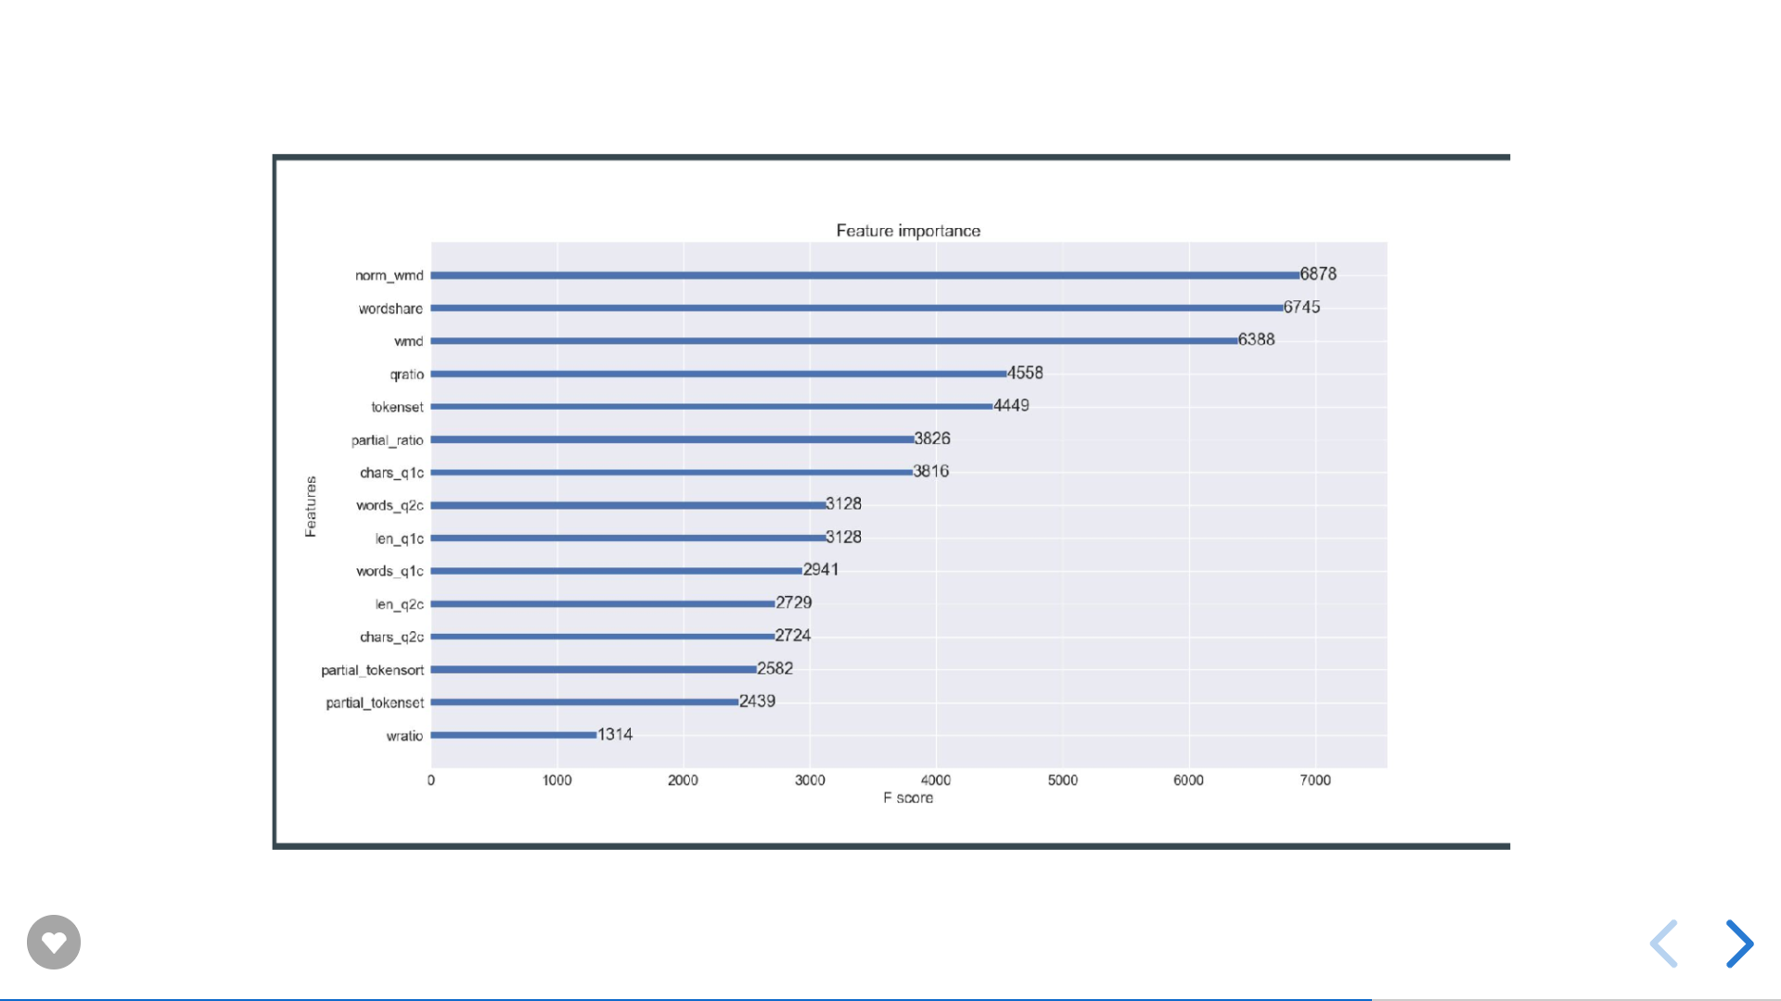

Slide 16
Creating set of independent variables
We have basic features and advanced features in hand
We’ll also use bag of words model to convert the processes questions into sparse metrices and use as a feature
Total we’ll have feature vector of 300+ elements(Xi)
On the basis of this Xi we need to determine Yi(0 or 1).

Slide 17
Models tried so far…
Random Model :-
Log loss on Test Data using Random Model 0.887242646958
It implies the worst case log loss is 0.88 and all better models should have log loss < 0.88
Logistic Regression :-
For values of alpha = 1e-05 The log loss is: 0.592800211149
For values of alpha = 0.0001 The log loss is: 0.532351700629

Slide 18
Future works
Try more ML models and see the accuracy
Find out more relevant features if possible

Slide 19
THANK YOU

